Slide 1
Serverless Functions and Middleware
Bhawna Gunwani
Corporate Trainer and Consultant

Slide 2
What is Serverless Function?

Slide 3
Serverless Functions
Serverless functions are small, independent pieces of code that run on-demand in a serverless computing environment. They execute specific tasks or handle specific HTTP requests, and you don't need to manage the infrastructure behind them. The term "serverless" doesn't mean there are no servers involved; it simply means that you, as the developer, don't have to manage the servers or worry about scaling.

Slide 4
Features
Event-Driven: Triggered by events such as HTTP requests or database changes.
Stateless: Each invocation is independent, with no memory of previous calls.
Scalable: Automatically scales based on demand without manual intervention.
Cost-Efficient: Pay only for execution time, not for idle server resources.
Ideal for Microservices: Perfect for isolated, small-scale tasks, and APIs.
Quick Scaling: Instantly scales to handle spikes in traffic.

Slide 5
Common Use Cases
APIs
Handle RESTful or GraphQL API endpoints.
Webhooks
Respond to events from external services
Microservices
Implement isolated, small-scale services.
Background Jobs
Perform asynchronous tasks like image processing or sending emails.
Authentication
Validate tokens, handle user login, and manage sessions.
Notifications
Send notifications like emails, SMS, or push messages.

Slide 6
How Serverless Function Works?
Deployment: Code is deployed to a serverless platform (e.g., AWS Lambda, Vercel).
Trigger: The function is triggered by an event.
Execution: The platform runs the function in a managed environment.
Scaling: The platform automatically scales the function to handle incoming requests.
Stateless: Each invocation is independent, with no memory of past executions.
Response: The function returns a response (e.g., data, result, or acknowledgment).

Slide 7
Example of Serverless Function
In a Next.js app, an API route is an example of a serverless function:
// pages/api/hello.ts
export default function handler(req, res) {
res.status(200).json({ message: 'Hello, World!' });
}

Slide 8
Benefits
Cost-effective (pay-per-use)
Auto-scaling
Faster deployment
High availability
Event-driven
Focus on business logic

Slide 9
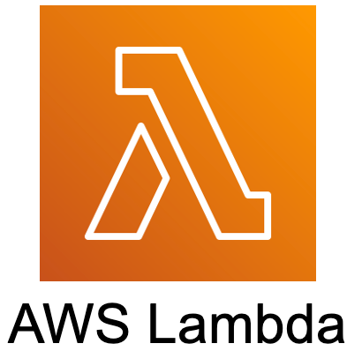



Serverless Platforms

Slide 10
What is Middleware?

Slide 11
What is Middleware?
Middleware is a piece of code that sits between the client and the server in a web application. It intercepts and processes requests and responses before they reach their final destination. Middleware functions are commonly used in web frameworks like Express (Node.js), Next.js, and others to modify or handle HTTP requests, responses, or even control the flow of the application.

Slide 12
Features
Response Processing: Modifies outgoing responses before sending them to the client.
Code Reusability: Enables reusable logic across multiple routes.
Error Handling: Centralizes error handling for consistent and clean error responses.
Granular Control: Can be applied globally, to specific routes, or conditions.
Security: Enforces authentication, authorization, and input validation.

Slide 13
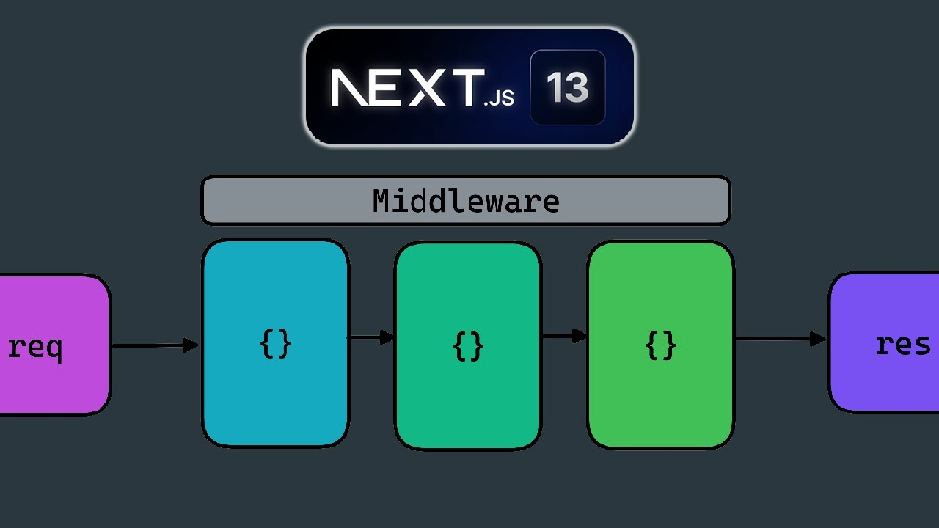

Slide 14
Breakdown of the Diagram
Request (req): Client request sent to the server.
Middleware Pipeline:
Series of functions that process the request.
Each middleware can inspect, modify, or act on the request.
Tasks in Middleware: Used for authentication, authorization, logging, etc.
Sequential Processing: Request flows through each middleware in order.
Response (res): Final response is sent back after passing through all middleware.

Slide 15
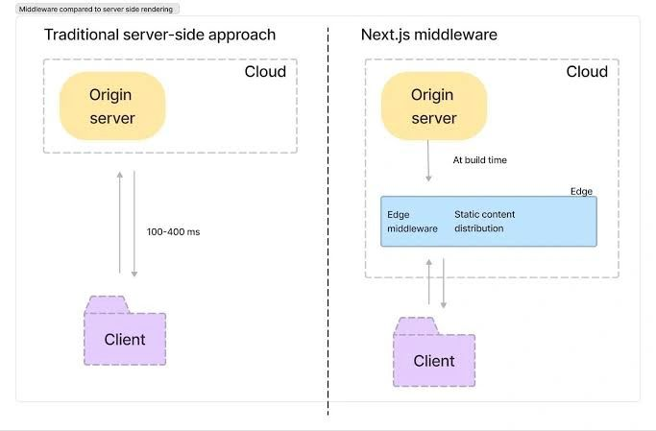

Slide 16
Types of Middleware
Application-Level
Route-Level
Error- Handling
Built-In
Custom

Slide 17
Benefits
Code Reusability: Apply logic across multiple routes.
Error Handling: Centralizes error management for consistent responses.
Security: Enforces authentication, authorization, and input validation.
Modularity: Easily add or modify functionality without changing core logic.
Customizable: Tailor middleware for specific needs.

Slide 18
Example
const express = require('express');
const app = express();
// Custom Middleware to log request details
app.use((req, res, next) => {
console.log(`Request URL: ${req.url}`);
console.log(`Request Method: ${req.method}`);
next(); // Pass the request to the next middleware
});
// Route handler
app.get('/home', (req, res) => {
res.send('Hello, Home!');
});
// Start the server
app.listen(3000, () => {
console.log('Server is running on port 3000');
});

Slide 19




Slide 20

Coffee Break

Slide 21

Check your Knowledge

